Slide 1

What will you do when you feel sick?
Like, if you have a headache and too lazy to go to the doctor

Slide 2
Maybe do a Google search…

Slide 3
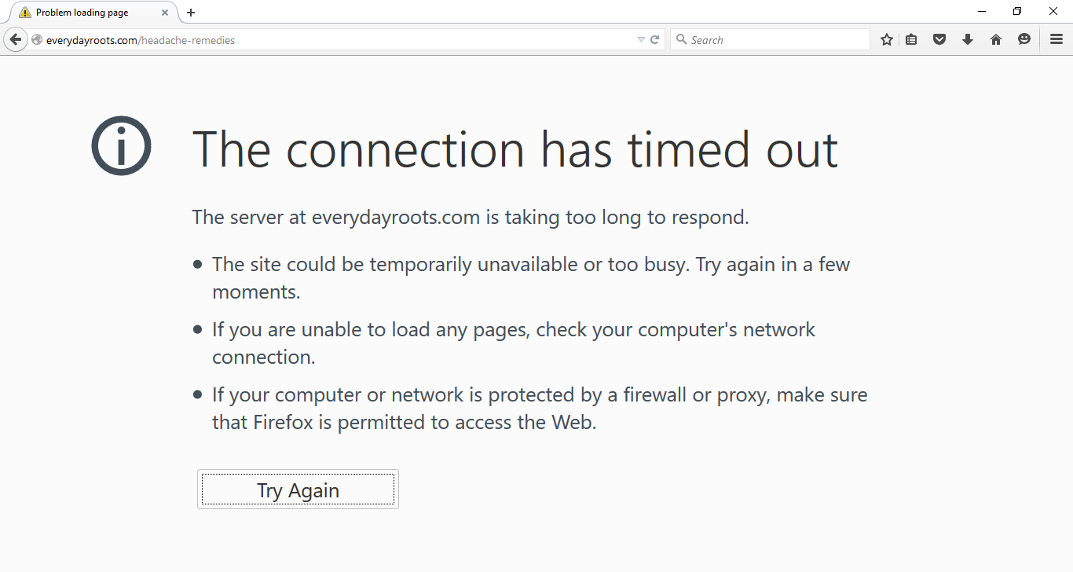
Well, if you are lucky you may find a solution…

Slide 4
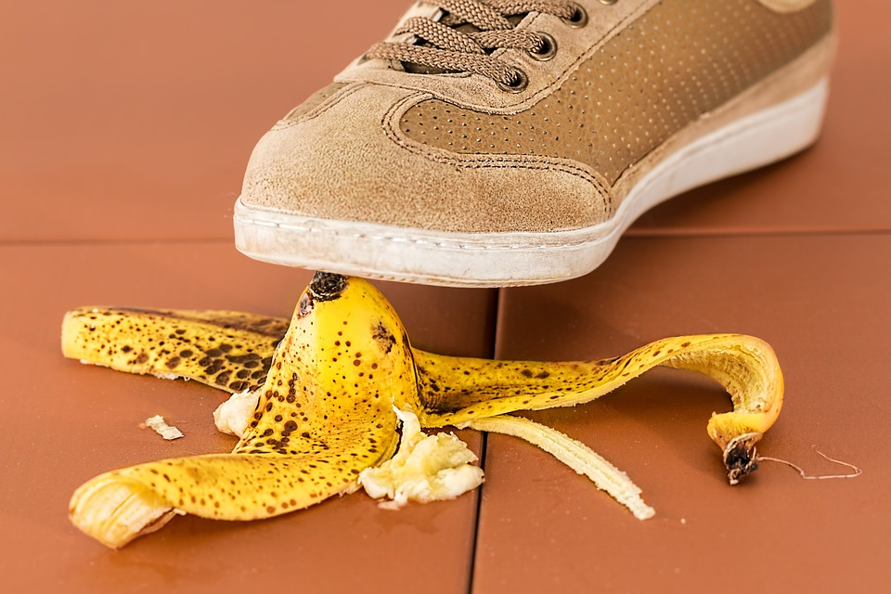
Why depend on your luck? Why risk your life when you can be safe? ;p

Slide 5

Presenting
DIAGNOSIA
The Symptom Diagnostics website by TESLA

Slide 7
Choose your symptoms
Diagnosia checks its database and displays diseases matching symptoms entered

Slide 8
Over 20 diseases compiled by experienced doctors (and more coming soon)
Databases will be updated regularly by doctors.

Slide 9

Find a list of most probable diseases, causes and remedies suggested by experienced doctors!
Also find doctors near your location! (feature coming soon)

Slide 10

Signup and login to get a personalised health card monitored by doctors for free*
* Offer valid only for first 100 users. Feature not yet developed. Terms and conditions apply

Slide 11
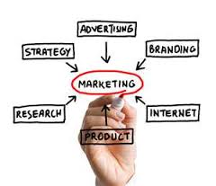
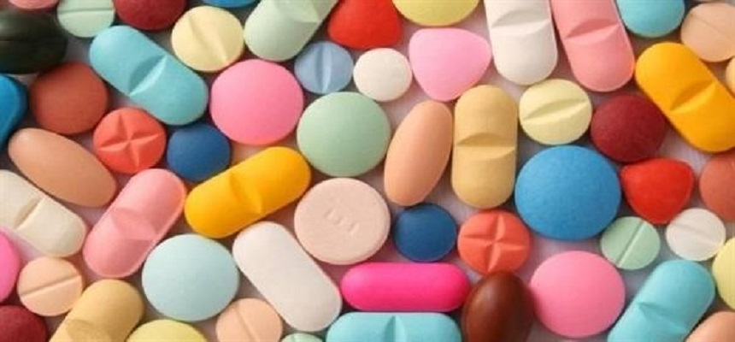
Sales and Marketing

Slide 12
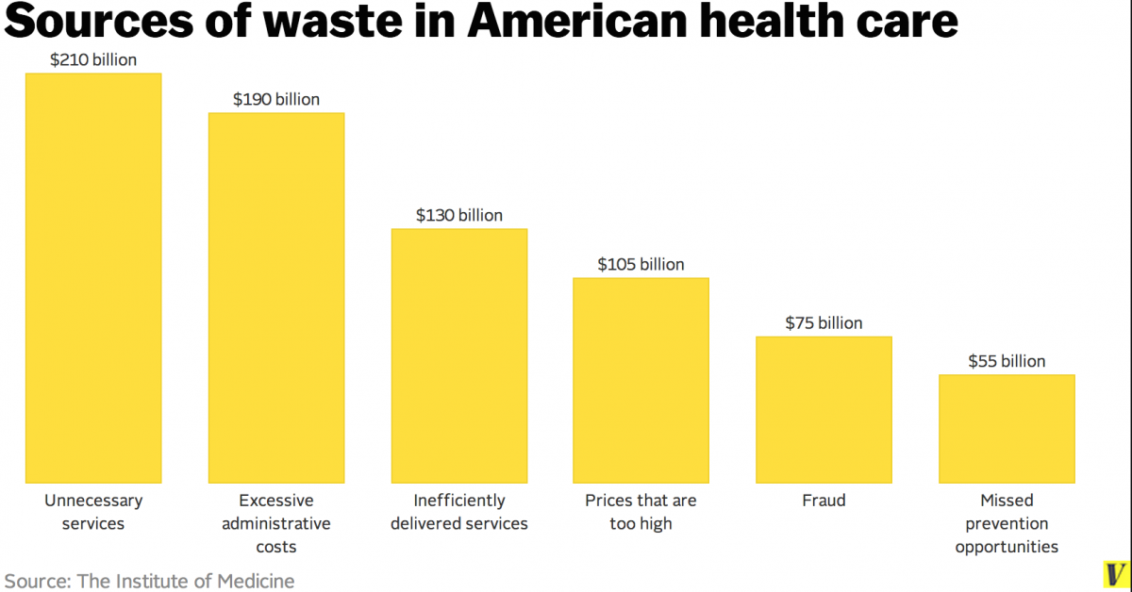

Slide 14
Credits
A BIG CREDIT TO OUR MENTOR ALLEN GJ CHETTAN
ARUN’S DAD
ARUN’S MOM
ARUN’S BROTHER
ASHAD’S BROTHER
MANU’S MOTHER
SOME OTHER DOCTORS
JOHNS’ LEFT EYE
FRESH DOCTORS ASSOCIATION

Slide 15
TESLA (Model Engineering College,Thrikkakara)
RAKESH KRISHNAN R (data collection, database) (EC)
ARUN JAYPRAKASH (back-end, database) (CS)
NAVANEETH K PARAMESWARAN (design, front-end ) (EC)
ROHAN ROY (back-end, database) (CS)
JOHNS T MONCY (database, design) (EC)
JESHRUN TOM (design, data collection) (EC)

